Slide 1
Introduction to Microsoft Azure
Group 5: Mallika Ghurye, Aditi Sharma & Sruthi Shyamsunder

Slide 2
Cloud OS Vision
1) Transform the data center
2) Unlocks insights on data
3) Enable people centric IT
4) Enable modern apps

Slide 3
Cloud Terminology
Infrastructure as a Service (IaaS): basic compute and storage resources
On-demand servers
Amazon EC2, VMWare vCloud
Platform as a Service (PaaS): cloud application infrastructure
On-demand application-hosting environment
E.g. Google AppEngine, Salesforce.com, Windows Azure
Software as a Service (SaaS): cloud applications
On-demand applications
E.g. Office 365, GMail, Microsoft Office Web Companions
Notes:
Added by Mallika

Slide 4
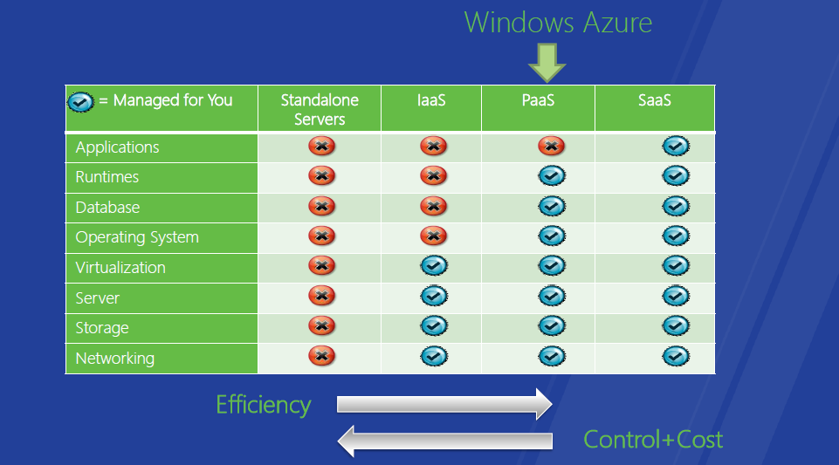
Notes:
Added by Mallika
Reference ...

Slide 5
Window Azure Technology
- access to public cloud through a website ( management or customer portal)
- range of IT services on top of Microsoft datacentres across the globe.
- Portal: Building resource clouds, automation, billing, tenant management, hosting plans.

Slide 6
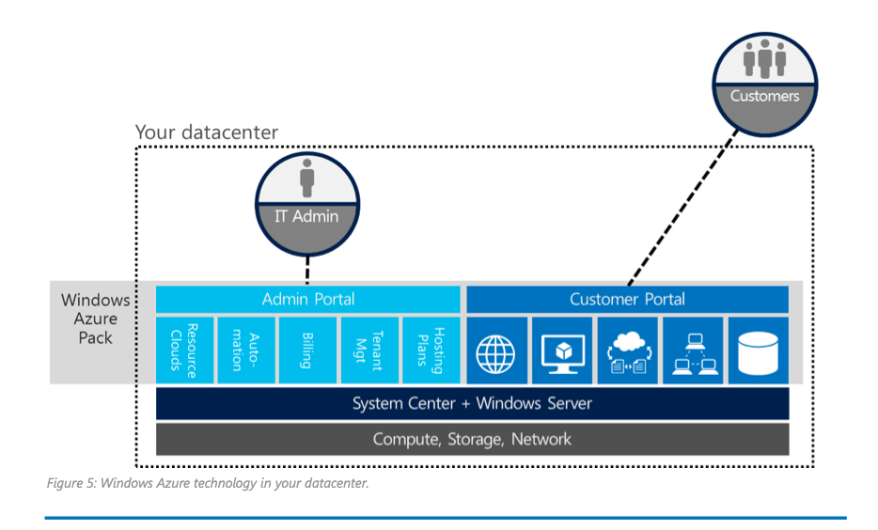
Windows Azure Pack for Windows Server, Oct ‘07

Slide 7
Windows Azure
Windows Azure is an OS for the data center
Model: Treat the data center as a machine
Handles resource management, provisioning, and monitoring
Manages application lifecycle
Allows developers to concentrate on business logic
Provides shared pool of compute, disk and network
Virtualized storage, compute and network
Illusion of boundless resources
Provides common building blocks for distributed applications
Reliable queuing, simple structured storage, SQL storage
Application services like access control and connectivity
Notes:
Added by Mallika
Reference ...

Slide 8
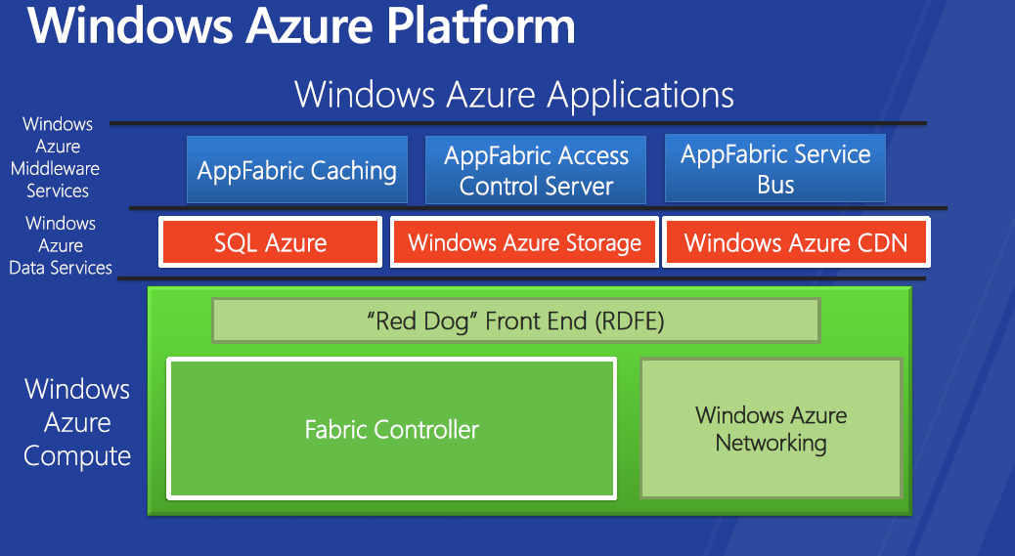
Notes:
Added by Mallika
Reference ...

Slide 9
Deploying a Service
A Windows Azure application is called a “service”
Definition information
Configuration information
To Deploy: Service package uploaded to portal
Windows Azure Portal Service passes service package to “Red Dog Front End” (RDFE) Azure service
RDFE converts service package to native “RD” version
RDFE sends service to Fabric Controller (FC) based on target region
FC stores image in repository and deploys and activates service

Slide 10
Fabric Controller
The “kernel” of the cloud operating system
Manages data center hardware
Manages Windows Azure services
Four main responsibilities:
Datacenter resource allocation
Datacenter resource provisioning
Service lifecycle management
Service health management
Inputs:
Description of the hardware and network resources it will control
Service model and binaries for cloud applications

Slide 11
Services
1) Management Portal
2) Service Management API
3) Website Service
4) VM service and Virtual Networking
5) Service Bus
6) Database

Slide 12
Web Sites service
The Web Sites service s a method of communication between two electronic devices over a network.
The Web Sites service helps you achieve the following:
Create high-density, scalable website hosting services that are simple to deploy and administer
Support application frameworks including ASP.NET, Classic ASP, PHP, and Node.js with full GitHub, BitBucket, DropBox,
The primary design point of the Web Sites service was to provide a cloud service that could operate at large scale. Windows Azure Pack makes this capability deployable on Windows Server

Slide 13
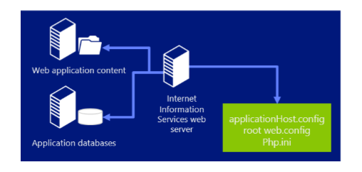
Traditional non-scalable web server

Slide 14
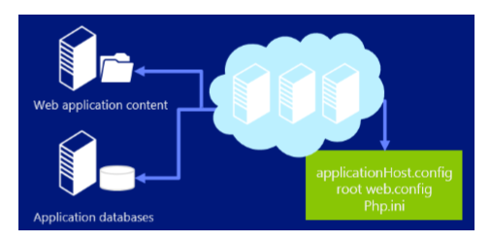
A cloud-based scalable web server farm

Slide 15
The Management Portal can be used to scale websites and to specify mode:
Free mode
Shared website mode
Reserved website mode

Slide 16
Windows Azure Pack enables to quickly create and deploy a web application created from the gallery. websites can be deployed from remote computers
The Web App Gallery supports a wide range of popular web applications developed by Microsoft, third party companies, and open source software initiatives.

Slide 17
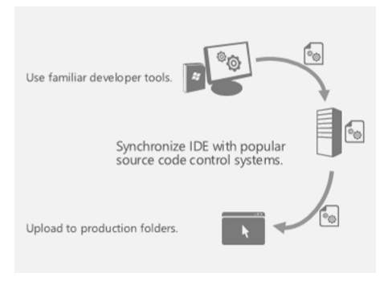
Developer tools and workflow automation using the Web Sites service.

Slide 18
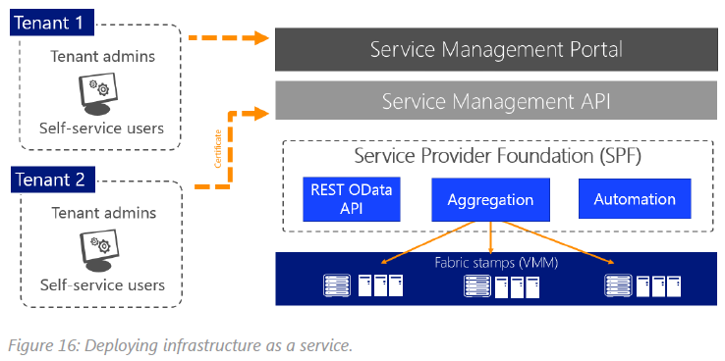
Virtual Machines

Slide 19
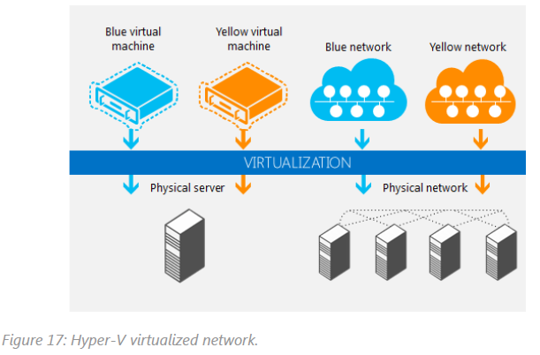
Virtual Networking

Slide 20
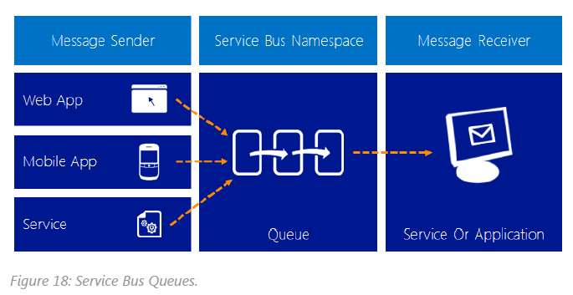
Service Bus Queues

Slide 21
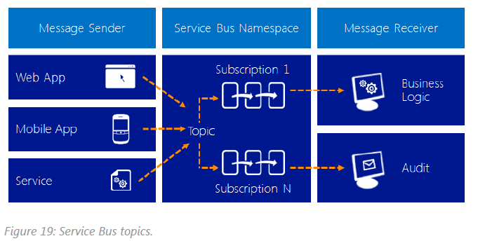
Service Bus Topics

Slide 22
Conclusion
The Cloud enables pay-as-you-go self-service provisioning of application resources
Platform as a Service is all about reducing management and operations overhead
Windows Azure enables you to develop and deploy scalable, highly-available applications in minutes
With Windows Azure, you can deploy code using any Windows language or runtime

Slide 23
References
Microsoft Azure White Paper
Introducing Windows Azure
Windows Azure Cloud

